Slide 1
PA-RTF Program & DMI Companies, Inc. Strategic Research Project
Key insights for custom sealant offerings
James Tyler, MBA/MS MIS Dual Degree Candidate
Namrata Duara, MS In Management and Business Analytics Candidate
Priyam Somani, MS in Marketing and Business Analytics Candidate
Jagadesh Nagendiran, MS in Management Information Systems Candidate

Slide 2
Executive Summary
Market Demand Analysis of regional trends, customer preferences, and purchasing decisions
Identifying customer pain points and gaps amongst DMI and its competitors
Delving into the opportunities that customization stands to gain in the market to differentiate from the competition
Previewing the concept of integrating customization with the sales and manufacturing operation
Recommendations for capitalizing on a customer-driven approach to product development
Regional trends indicate a need for customer solutions
Drying time, durability, and price are leading factors in buying decisions
Customization improves customer leads, product development, and differentation from competitors
Technology solutions exist for DMI to integrate an interactive customization tool on the company website
More customer engagement strategies will attract more interest in Ductmate sealants

Slide 3
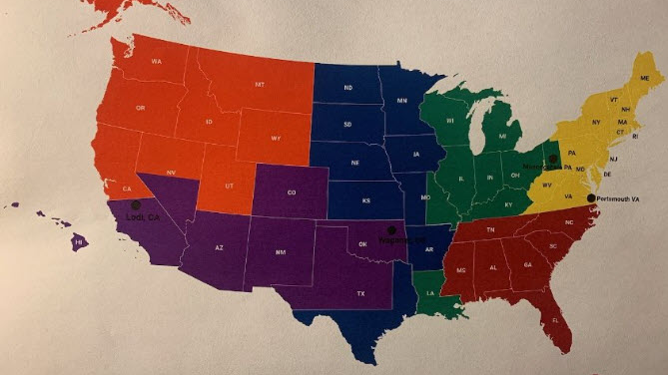
Region Map

Slide 4
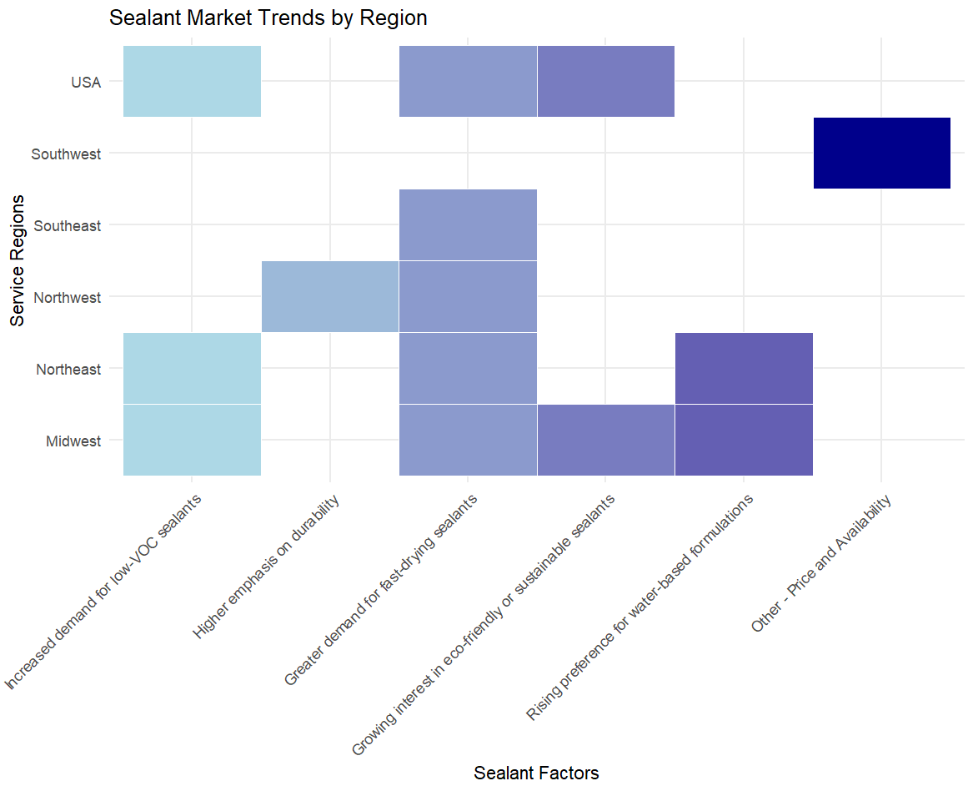
Key Sealant Market Trends by Region
Environmental Demand:
High demand for low-VOC and eco-friendly sealants in the Midwest, Northeast, and USA-wide regions, reflecting a shift towards sustainability.
Durability & Fast-Drying Preferences:
Durability is particularly valued in the Northeast, while fast-drying sealants are prioritized in every region except Southwest.
Cost Sensitivity:
Price and availability concerns are dominant in the Southwest, indicating a strong preference for affordable solutions

Slide 5
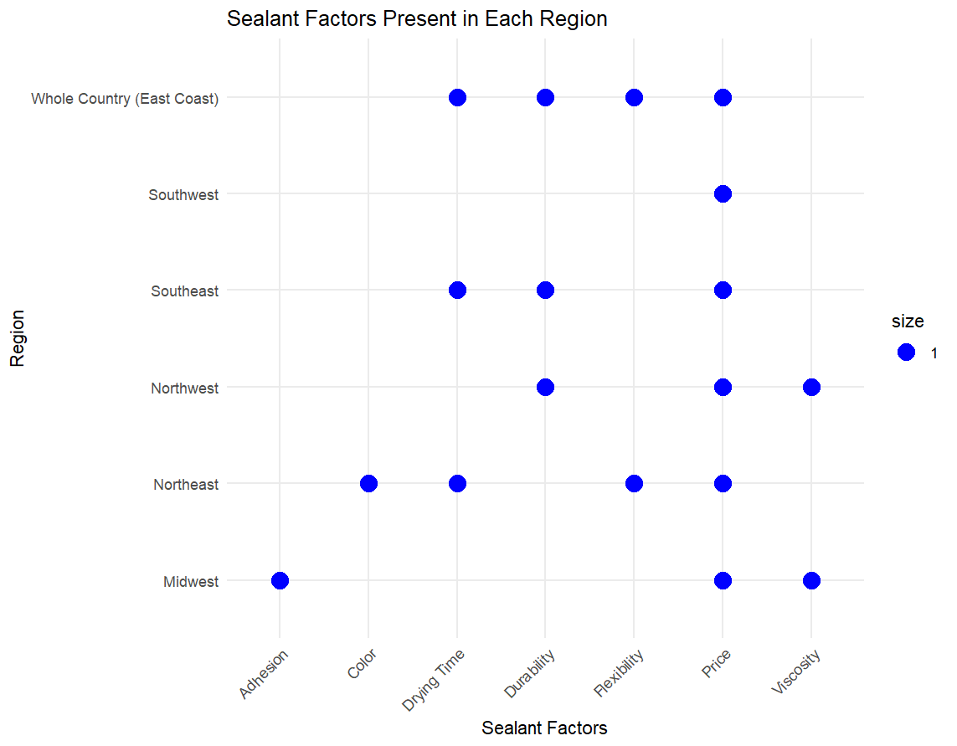
Important Factors by Region

Slide 6
Durability Definition
Resistance to Cracking and Peeling: Customers expect the sealant to maintain integrity in specific applications, particularly outdoors, where it must withstand high UV exposure and moisture without cracking or peeling.
Performance in Adverse Conditions: The sealant should be durable enough to hold up in challenging environments, meeting stringent testing standards for long-term reliability.
Perception of Durability: When customers consider durability, they think of the sealant's lifespan post-application, specifically how well it will endure under conditions like weather and UV exposure without compromising the seal.
Shelf Life and Open-Container Longevity: Customers value a sealant that has a long shelf life and remains effective even after opening, allowing for prolonged use.
Long-Lasting, Tight Seal: A durable sealant should be able to maintain a tight seal over time, enduring various conditions without deterioration.

Slide 7

Unmet Customer Requests
Some customers seek a UL 181-A certified sealant for residential applications, which Ductmate currently does not provide.
There is also demand for a white-colored sealant, a product option that is currently unavailable in Ductmate’s lineup.
Price Sensitivity: A segment of customers prioritizes low cost over performance, expressing interest in a budget-friendly sealant even if it comes at the expense of durability or quality.

Slide 8
Sealant Factors Influencing Regional Markets
Fast-Drying Sealants: Reduces labor time, balances consistency ("not too goopy/watery").​
Price Sensitivity: Competitive pricing essential; focus on cost-effective quality over competitors.​
Ease of Application: Highlight Green Seam tech for labor-saving, streamlined application.​
Environmental Durability: Products withstand heat/humidity; market as standard durability.​

Slide 9
Strategic Opportunities highlighted during Interviews
Standard Products Focus: Prioritize standard, efficient, and affordable solutions.
Experiential Marketing: In-person demos, samples, and videos for contractor engagement.
Feedback Collection: Focus on in-person events with web forms as supplementary, incentivized option.
Brand Recognition: Emphasize product identifiers (e.g., lid colors) to boost brand recall.

Slide 10
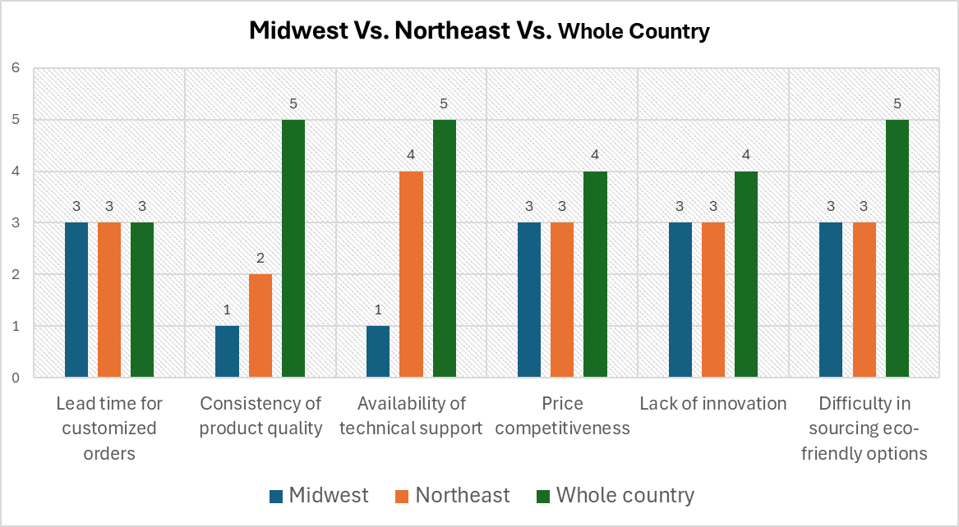
Customization Fulfills Specific Needs For Customers In Different Regions
While the country performs well in product quality, technical support availability, and sourcing of eco-friendly products, the Midwest and Northeast face challenges in those areas.
Very Poor | Poor | Average | Good | Excellent
1 | 2 | 3 | 4 | 5

Slide 11
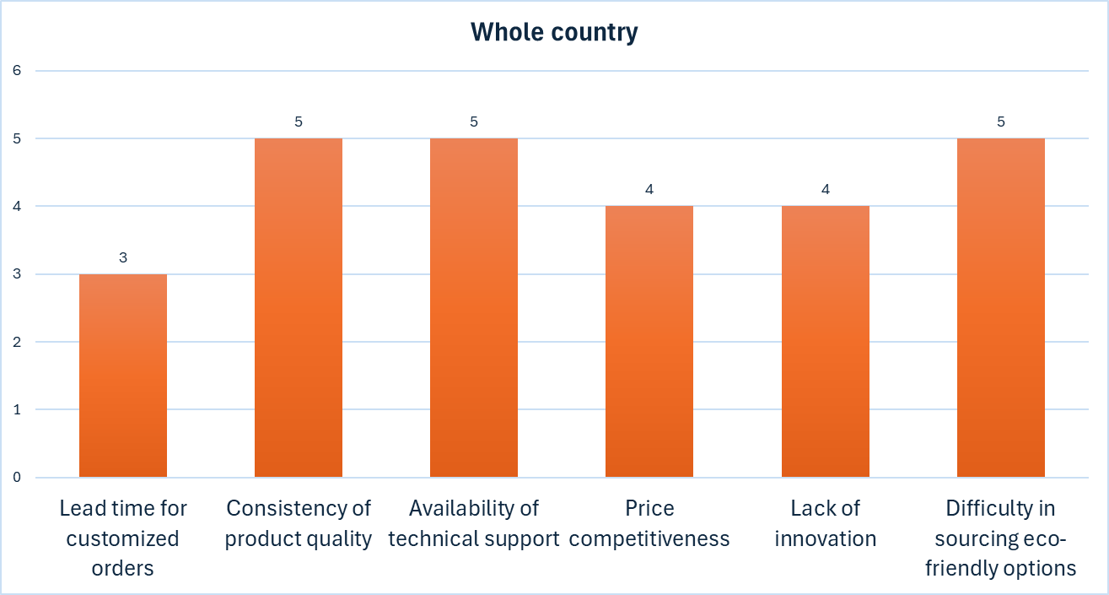
Customization to address lead time challenges across the country
Lead time seems to be a concern throughout the country.
Customization of sealants would allow DMI to adapt to varying lead times and align with regional market dynamics.
Very Poor | Poor | Average | Good | Excellent
1 | 2 | 3 | 4 | 5

Slide 12
The shift toward water-based and Non-VOC sealants
Rising Demand for Water-Based Sealants: water-based sealant solutions are free from harmful VOCs
LEED Certification Compliance: The increasing requirements for LEED certification are pushing companies towards Non-VOC and water-based solutions
Rising Demand for Water-Based Sealants: water-based sealant solutions are free from harmful VOCs
LEED Certification Compliance: The increasing requirements for LEED certification are pushing companies towards Non-VOC and water-based solutions

Slide 13


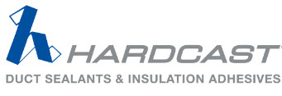

Competitor Landscape

Slide 14
How Do Competitors Approach Customization?
Design Polymerics | Polymer Adhesives | Carlisle HVAC (Hardcast)
Implies custom formulations online but not really | Promotes Custom Formulation with a hyperlink but not interactive | Features an interactive selection tool but focuses on savings not custom formulation
example | example | example

Slide 15
Ductmate Stands Out With Customization Tool
Enhances customer insights to capture valuable data on specific preferences
Improves customer experience by giving a sense of personalization, tailored to specific needs
Provides a strategic advantage over competitors by offering a forward-thinking and customer-centric solution
Builds a database of customer preferences over-time that tracks market trends guiding future product development
Streamlines the sales process by reducing formulation validation time

Slide 16
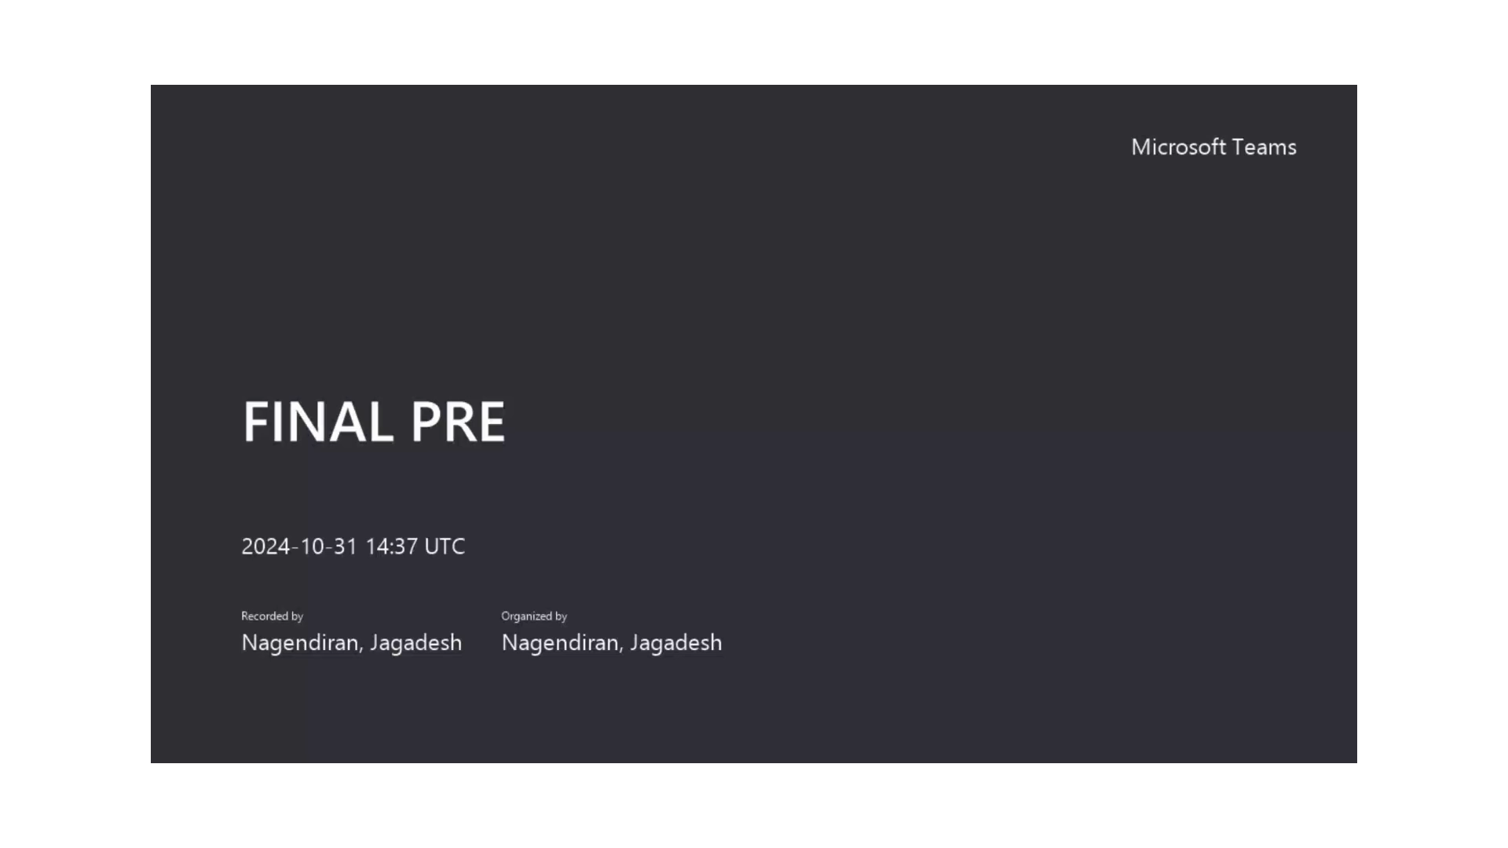
Imagining the possibilities of customization

Slide 17
Conclusion
DMI’s current position in the market for HVAC Sealants is prime for seizing the opportunity that customization presents
As seen in this presentation, other key players are trying to address this opportunity but fall short on developing an effective tool that captures what customers truly need in real-time
We’ve demonstrated that DMI can become an industry leader in innovation with a customer-centric approach to developing custom superior products an evolving HVAC Sealant market

Slide 18

Next Steps
Pursue technology solutions that will collect and manage customer behavior
Develop a customization tool that captures customer preferences with built in formulation factors based on customer feedback and market trends
Prioritize opportunities in regions that will benefit from tailored products in their distinct market segments

Slide 19

Thank You

Slide 20

Appendix

Slide 21
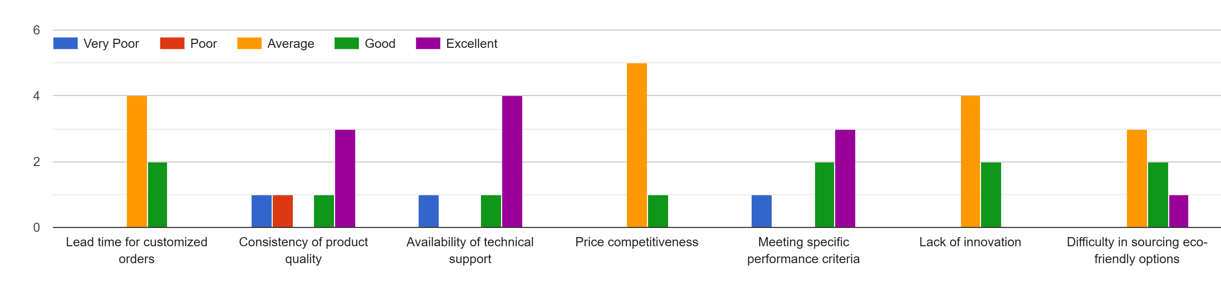
Sealant performance in addressing varying challenges

Slide 22
Overall performance and regional variations in addressing varying challenges
Northeast | Southeast | Midwest | Northwest | Whole Country
Good technical support is available. | There's consistency of product quality and availability of technical support. | Price competitiveness has moderate ratings, along with lack of innovation and eco-friendly products | Product quality, availability of technical support, meeting performance criteria have indicated consistent performance. | Product quality, availability of technical support, meeting performance criteria, and sourcing eco-friendly products have shown good performance.
Product quality, price competitiveness, and lead time for customized sealants are a concern. | Price competitiveness has a below average performance and is a concern. | Product quality, availability of technical support, meeting performance criteria are a concern. | Price competitiveness, lead time, and lack of innovation have a below average rating and are a concern | Lead time, price competitiveness, and innovation could be improved.

Slide 23
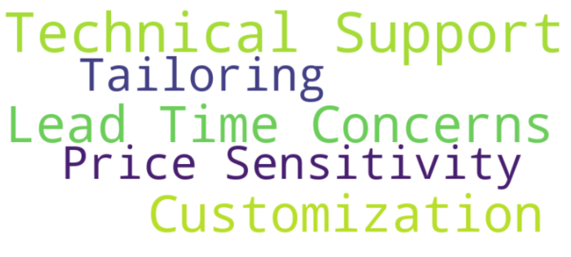
While customization is increasingly in demand, regions are grappling with maintaining short lead times, ensuring price competitiveness, and upholding quality

Slide 24
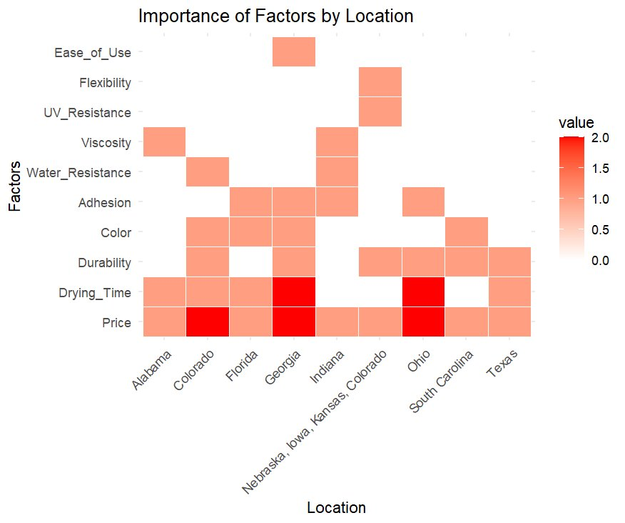
Distributors survey analysis
Drying Time is a top priority in humid regions like Florida, while Price is crucial in states like Ohio, Georgia, and Texas.​
Moderate importance is placed on factors like Durability, Adhesion, and Color, but they are secondary to drying time and price.​
Low priority factors such as UV Resistance and Flexibility show little impact across all regions, indicating limited customer focus on these attributes. ​

Slide 26
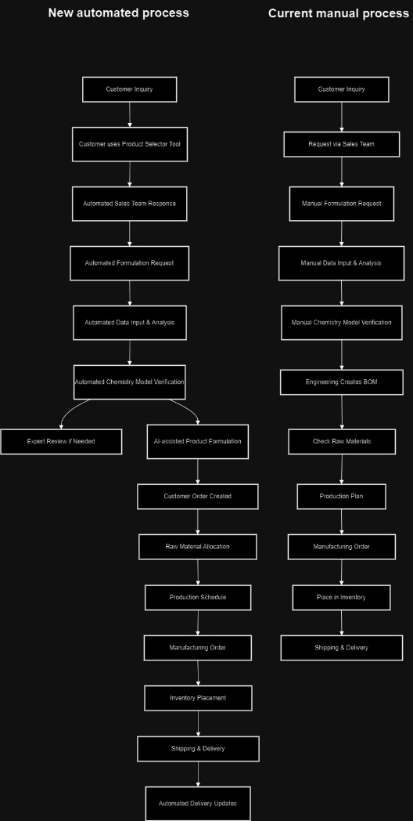
Manual process

Slide 27
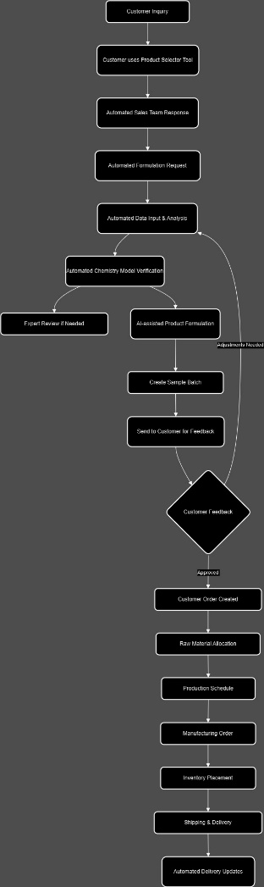
DMI New process

Slide 28
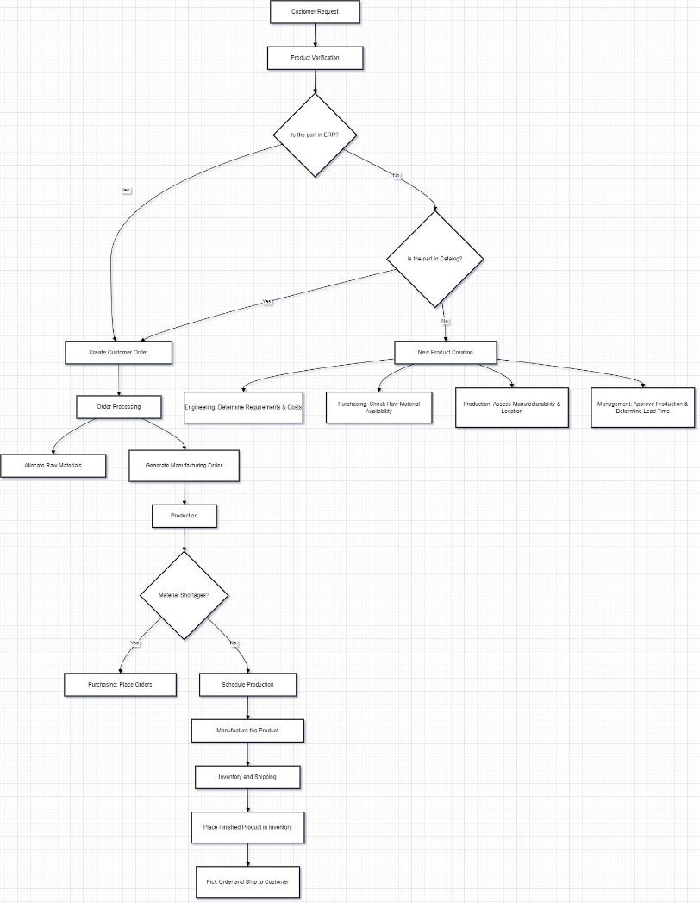
CPQ

Slide 29
Manager Survey Data

Slide 30
Region Survey Data

Slide 31
Test link to customization tool
Demo Customization Tool

